Slide 1
01
Project Scope

Slide 2



Benefits of the Project
Saving Labeling Cost (reduce ~80% of labeled data needed)
Broad Use Cases (support development of other ML projects)
Improve Model Maintenance Process

Slide 3
Model Pipeline
Label Model
Spam Classifier
Topic Model
Noisy Label
Non-Spam (Ham) Emails
Label the large dataset with small amount of hand-labeled data
Classify unwanted spam emails
Extract the topics of remaining emails for future use

Slide 4
02
Model Development
Spam Classifier - Planning

Slide 5
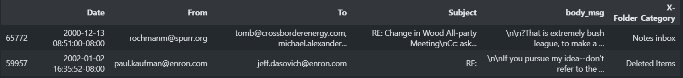
Dataset
Enron Emails Dataset – Jeff Dasovich’s Email
26,371 emails
63 folders
From 1999 to 2002

Slide 6


Goal of the Spam Classifier
Precision
90%+
Coverage

Slide 7
02
Model Development
Labeling Model - Snorkel

Slide 8

Snorkel

Slide 9
External Emails (1999 – 2002, ~8000 emails)
400 randomly selected emails
remaining emails
(~7400)
600
latest emails
Snorkel Set
Unlabeled Set
Validation Set
Manually Labeled
Tuning Label Functions
Randomly selected from unlabeled data
For training Snorkel Label Model
Manually Labeled
Held-out for testing discriminative model
Latest Emails in the dataset

Slide 10
Developing Label Model
4
1
Optimze Labeling Functions
Develop Labeling Functions
3
2
Test on the Snorkel Set
Train Label Model on unlabeled data

Slide 11
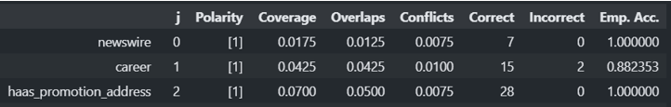

Labeling Functions

Slide 12
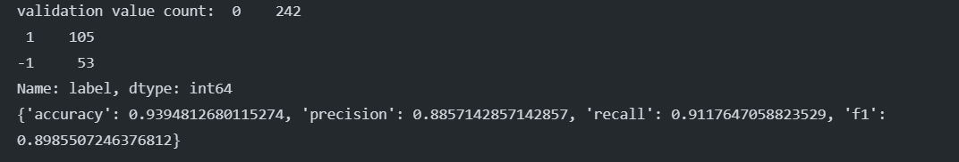
Label Model - Performance on Snorkel Set
Precision | 88.57%
Recall | 91.18%
% of Data Labeled | 86.75%

Slide 13
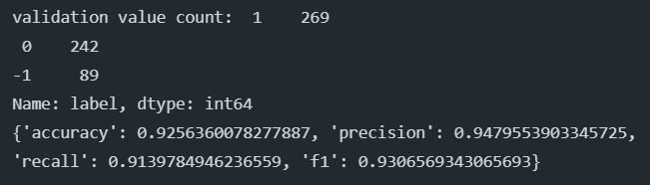
Label Model - Performance on Validation Set
Precision | 94.80%
Recall | 91.40%
% of Data Labeled | 85.17%
Better than Snorkel Set

Slide 14
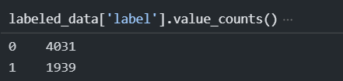
Label Model - Model Output
Output:
4031 Ham Emails
1939 Spam Emails

Slide 15
02
Model Development
Spam Classifier

Slide 16
Labeled External Emails (1999 – 2002, ~6600 emails)
Randomly select 70% of emails
Randomly select 30% of emails
600
latest emails
Train Set
Test Set
Validation Set
Data to be used to train the classifiers
For hyperparameters tuning
Manually Labeled
Held-out for testing discriminative model

Slide 17

Evaluation Methods
Precision
90%+
Coverage
Generalization

Slide 18
Preprocessing Approaches
Pre-trained Word Embeddings
Google’s Pretrained Word2Vec Model Vector size: 300
Word Embeddings
Trained by training set emails Vector size: 300
TF-IDF
Trained by training set emails Vocabulary Size: 944

Slide 19
Classifiers
Decision Tree
XGBoost
Random Forest
Support Vector Machine
Logistic Regression
Combined into
Final Ensemble Model
Considering the size of the dataset. Deep Learning Algorithms is not used.

Slide 20
Model Result
 | Google Word2Vec | Word2Vec | TF-IDF
Train Set | Precision: 94.43% Recall: 87.51% | Precision: 94.39% Recall: 89.30% | Precision: 95.07% Recall: 86.61%
Test Set | Precision: 91.56% Recall: 84.71 % | Precision: 92.25% Recall: 89.04% | Precision: 94.53% Recall: 86.21%
Validation Set | Precision: 94.46% Recall: 84.49% | Precision: 90.60% Recall: 89.10% | Precision: 95.88% Recall: 84.49%
Snorkel Set | Precision: 86.09% Recall: 83.19% | Precision: 90.09% Recall: 84.03% | Precision: 90.57% Recall: 80.67%

Slide 21
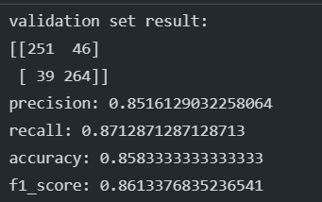
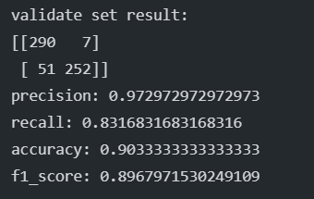
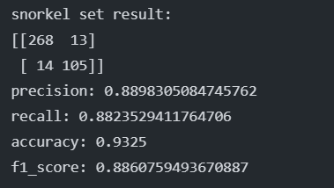
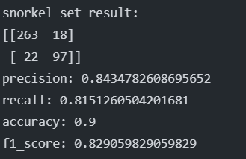
Other Model Result
W2V with Bigram & Lemmatization
TF-IDF with Bigram & Lemmatization

Slide 22
Spam Classifier - Model Output
Output:
5256 Ham Emails – To be used in Topic Model 2852 Spam Emails

Slide 23
02
Model Development
Topic Model

Slide 24
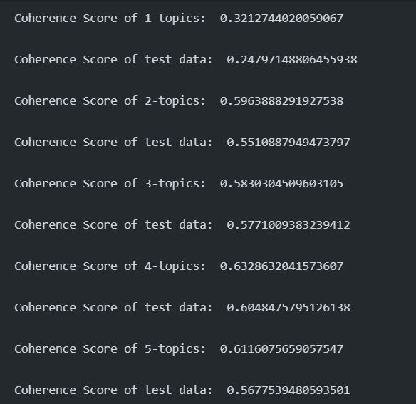
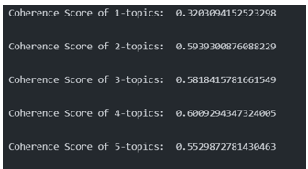
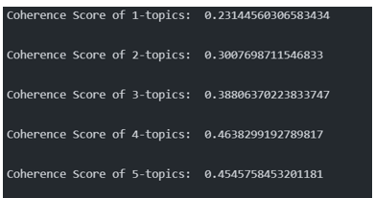
Model Selection
Latent Dirichlet Allocation (LDA)
LDA Mallet
Latent Semantic Analysis (LSA)

Slide 25
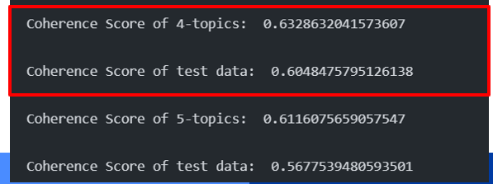
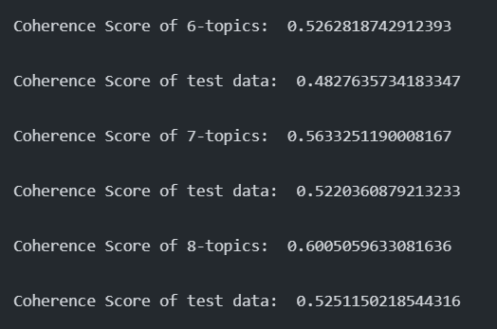
Number of Topics

Slide 26
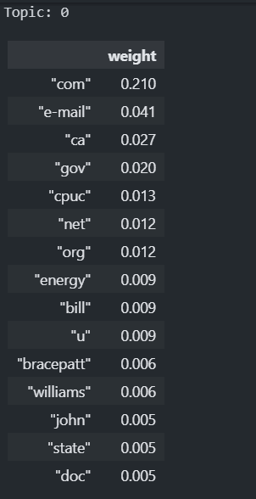
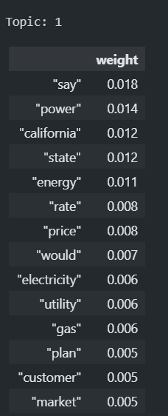
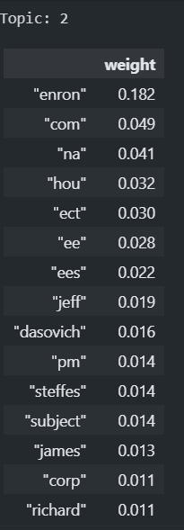
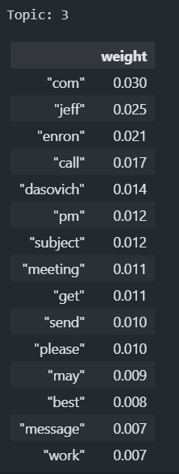
Top 15 words in each topic

Slide 27
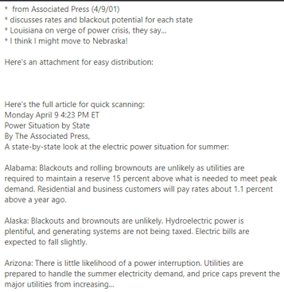
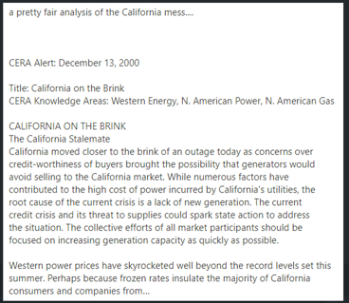
LDA topic 1 – California Energy Issues

Slide 28
Topic Model - Model Output
Output:
Emails are sorted into 4 topics
government parties
California Energy Issue
Meetings related
others
A Vector indicating the likelihood of the email in each topic

Slide 29
Model Maintenance
Snorkel + Spam Classifier
Metrics: Drop in Precision (Validation vs New Emails)
Redevelopment: Precision drops > 2.5%
Evaluation Frequency: 1 year
Metrics: Drop in Coherence Score (Test vs New Emails)
Redevelopment: Coherence score drops > 3%
Evaluation Frequency: 6 months
Remark: Other ML models need to re-tune hyperparameters if the redevelopment is performed
Topic Model

Slide 30
03
Business Use Case

Slide 31
Use Cases in business
Email Classification Engine
Spam classification
Segmenting emails into topics.
As an input in other email ML models
The development process can be applied to other topic classification (e.g. casual chat, meeting frequency)
Can be applied to imbalance classes problem (requires extra steps, e.g. data augmentation, up-sampling, down-sampling)
Snorkel + Spam Classifier

Slide 32
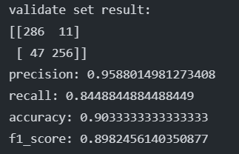
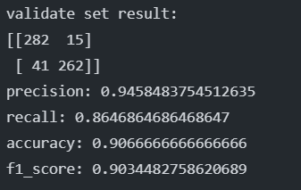
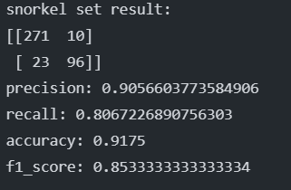
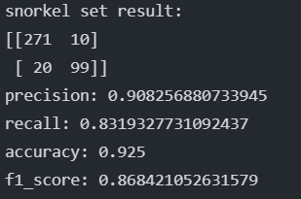
Example of using Topic Model as Input
Without Topic Vector
With Topic Vector

Slide 33
Thank you!

